Slide 1
The History of Large-scale Coordination
Ben Koo
benkoo@tsinghua.edu.cn
March 10th，2020
Notes:
今天的主题是“区块链启发的新产业范式”

Slide 2
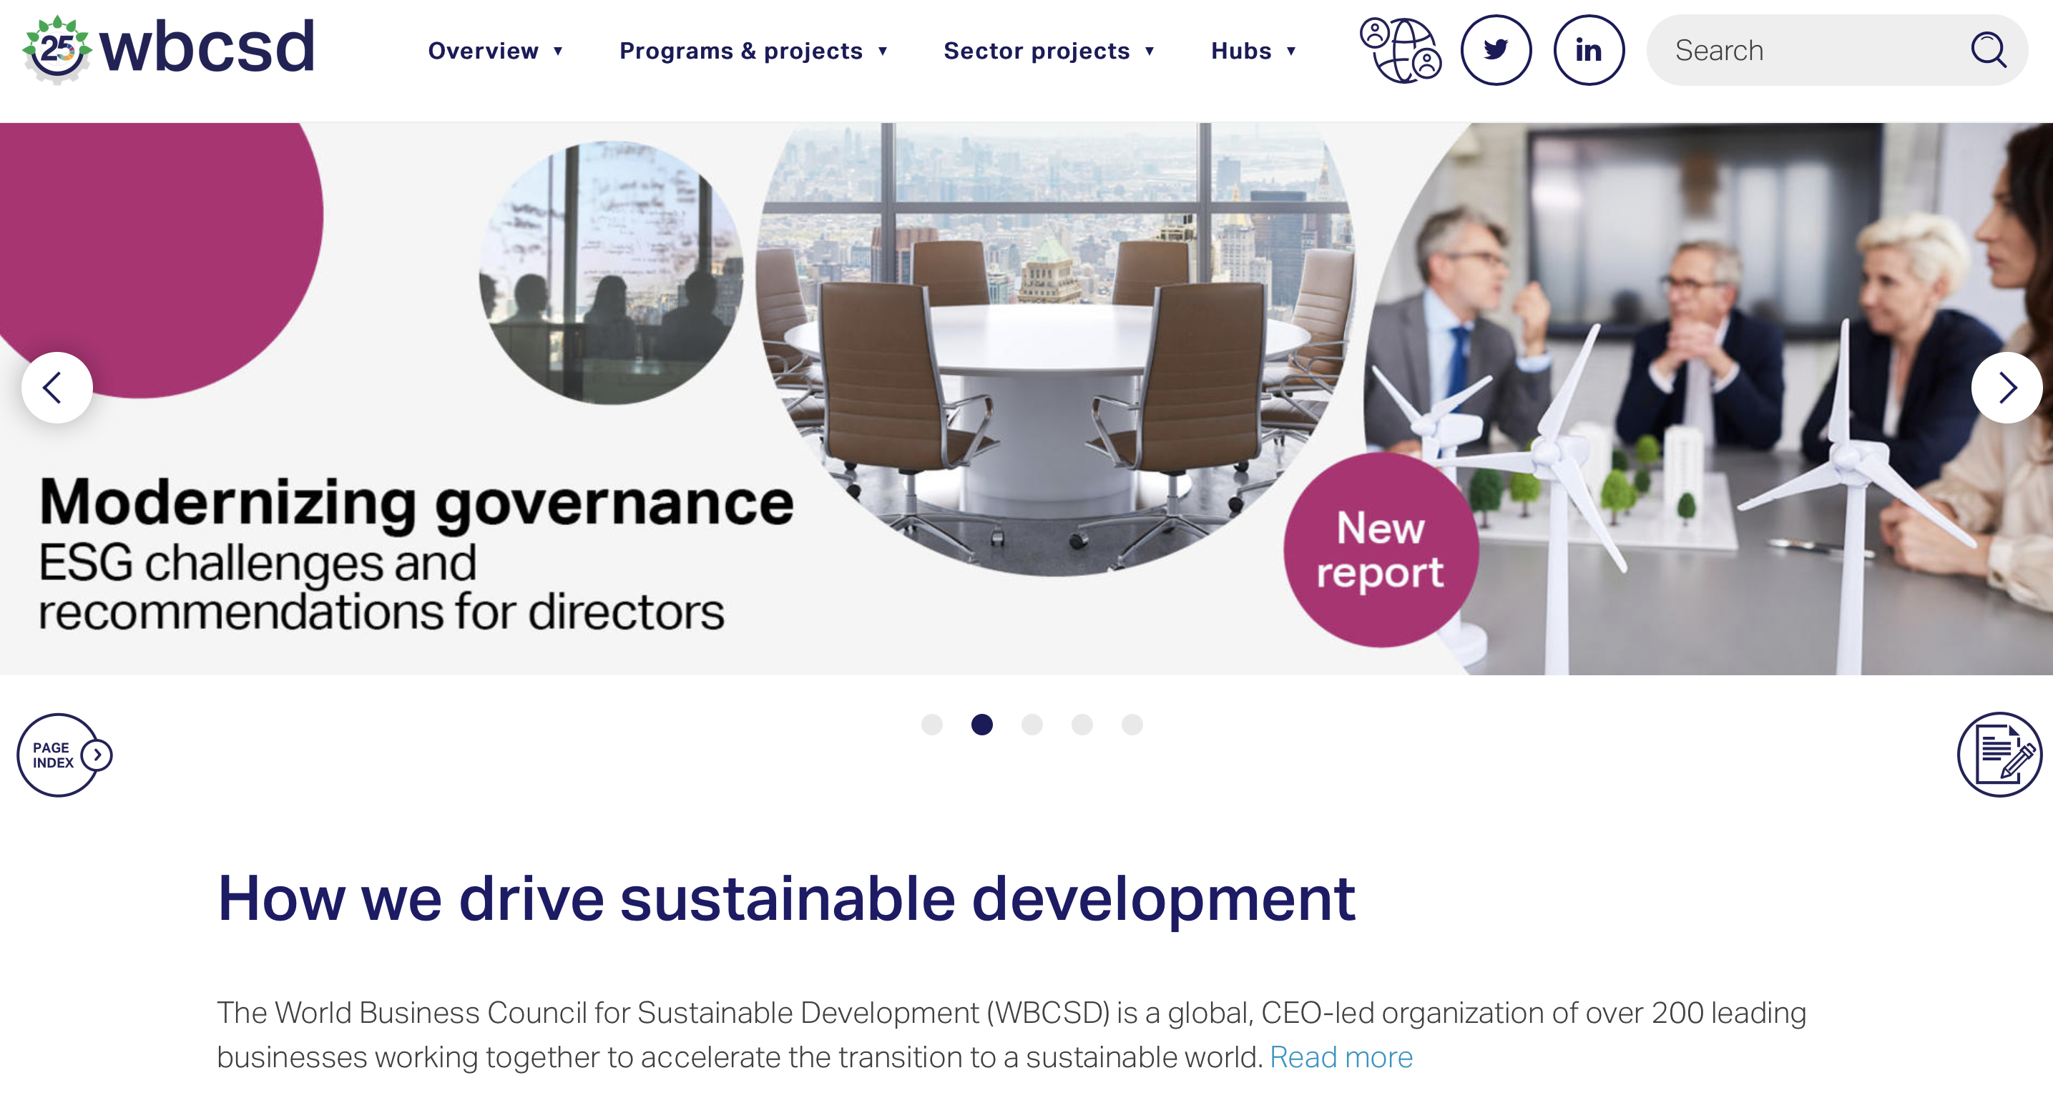
Governance at a Global Scale
CEO of wbcsd
Peter Bakker

Slide 3

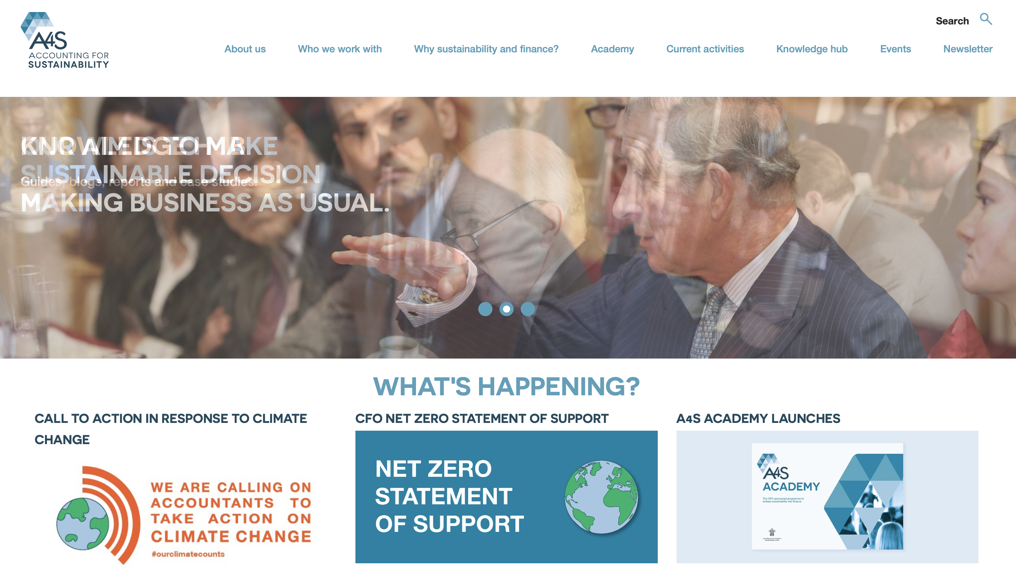
Accountants will Save the World
Excerpt: “If the world wants to address our many challenges — if business wants to restore societies’ trust — business must be more transparent and acknowledge that the resources we exploit or conserve and the social benefits we engender or lose, must be factored into a company’s value and thus into day-to-day management. This is not a matter of incremental change, but a radical transformation. And it’s the accountants who will lead the way.”
https://hbr.org/2013/03/accountants-will-save-the-worl
CEO of wbcsd
Peter Bakker
March 05, 2013

Slide 4

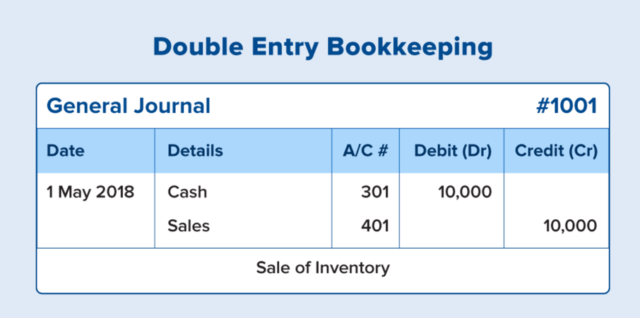
History of Accounting
Luca Pacioli invented Double Entry Book Keeping during the Renaissance.

Slide 5
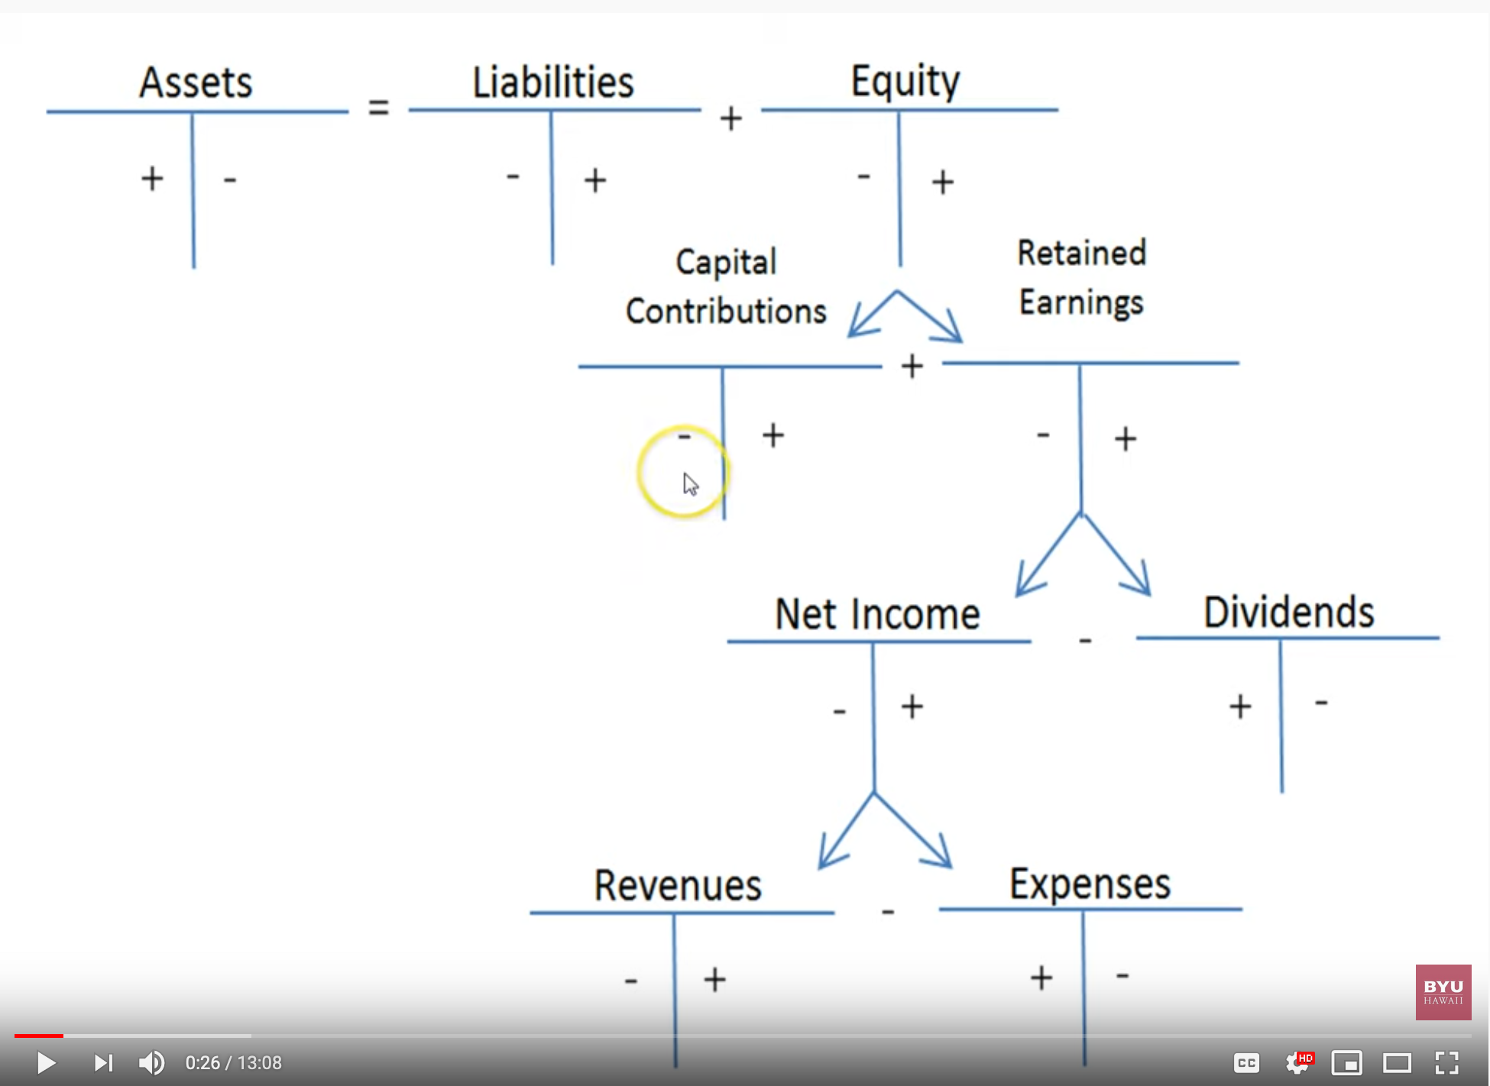
Debits and Credits and the Expanded Accounting Equation
Image source: https://youtu.be/gIWmPrUDj_M

Slide 6


复式记账启蒙了西方科学和艺术的发展
1494 1st Ed.，1523 2nd Ed.
Pacioli was primarily remembered by Double Entry Book Keeping
Pacioli worked with da Vinci to create paintings and sculptures
Summa de arithmetica, geometria, proportioni et proportionalita （算术、几何、比与比例概要）
“historian James Aho linked double-entry bookkeeping to the ancient art of rhetoric, … medieval merchants used double-entry bookkeeping as a rhetorical tool of capitalist propaganda, to persuade their ‘audience’ that their business was honest, morally sound and its profit-making ethically justified.”
Excerpt From: Jane Gleeson-White. “Double Entry.”
Notes:
“historian James Aho linked double-entry bookkeeping to the ancient art of rhetoric,”
Excerpt From: Jane Gleeson-White. “Double Entry.” Apple Books.

Slide 7
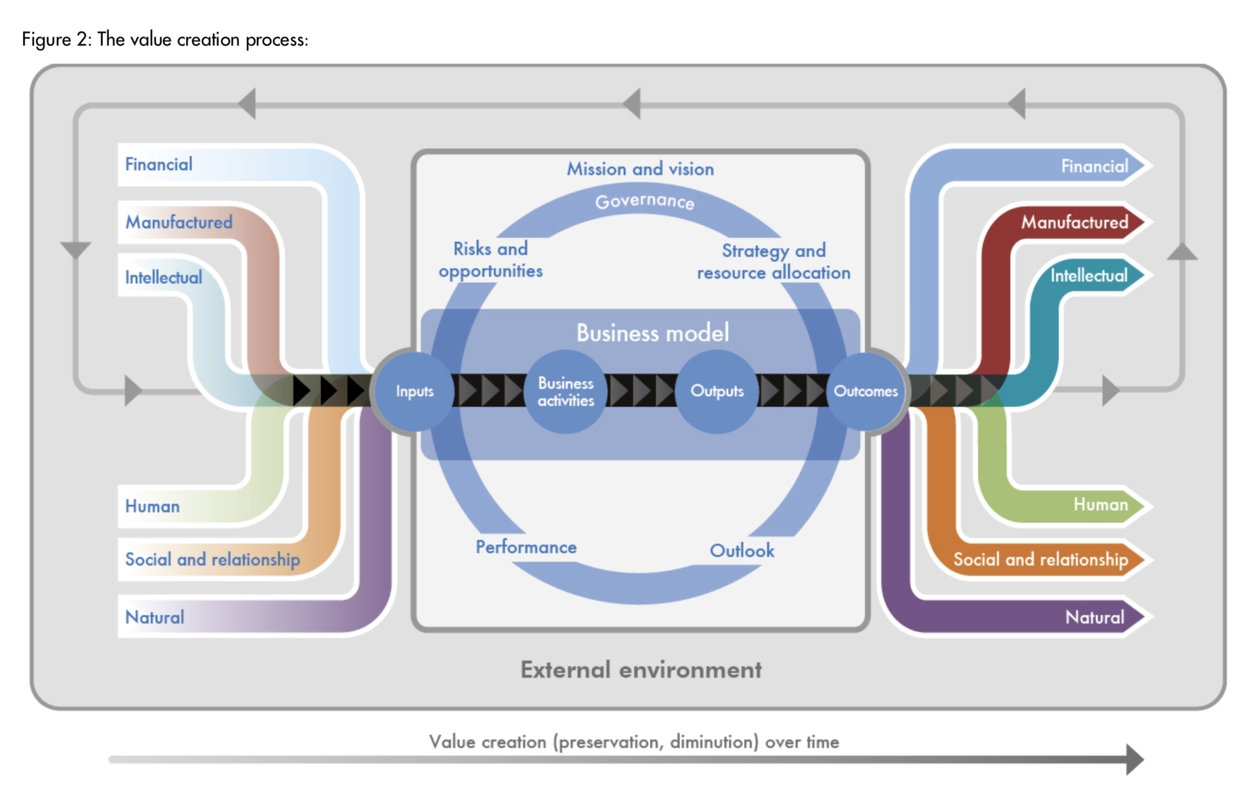

Accountants’ Value Proposition
The International
Integrated Reporting
Framework
Dec. 2013
Notes:
“historian James Aho linked double-entry bookkeeping to the ancient art of rhetoric,”
Excerpt From: Jane Gleeson-White. “Double Entry.” Apple Books.

Slide 8
Context: Describe the Spatial and Temporal boundaries of the project.
Abstract Specification
Goal: Mission Statement written in an imperative sentence with reference to “Context”.
Measurable Effects: Conditional statements of the observable implementation outcomes that satisfy the “Goal”.
Concrete Implementation Process
Inputs
Prescribe the required resources to be consumed in the implementation Process
Activities
A structured set of actions that depicts implementation activities.
Ideally written in a formalized process specification language
Outputs
A list of noun phrases that declares the deliverable items from proposed activities
Boundary Conditions: When and how the boundaries of the previously defined ”Context” could be broken?

Slide 9

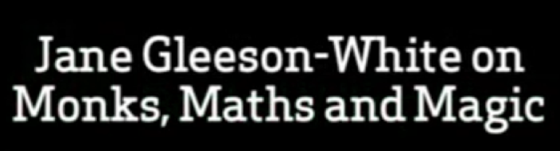


复式记账 ：僧人，数学与魔法
https://youtu.be/jmVfDbqRxKo

Slide 10
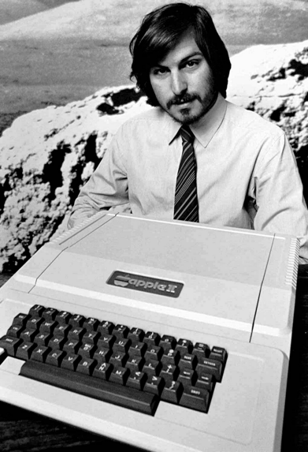
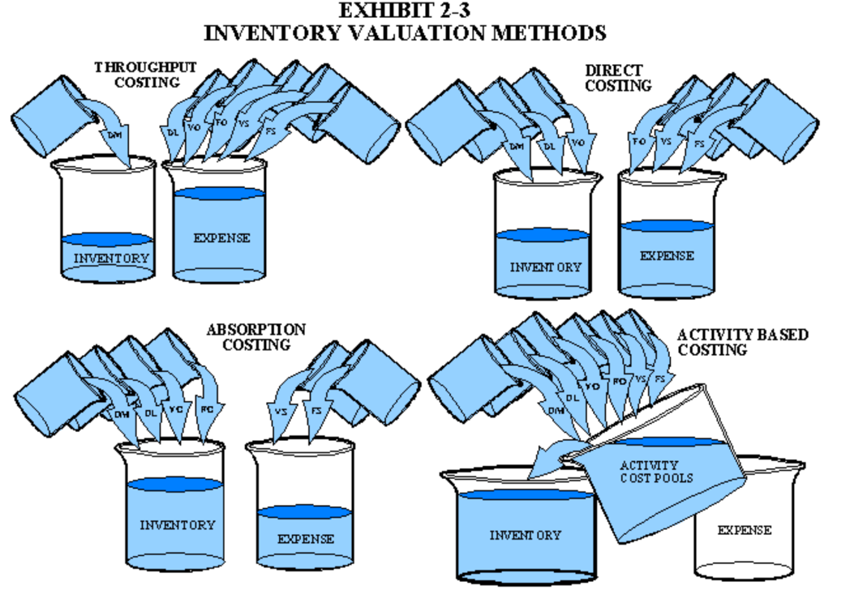
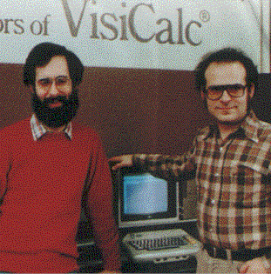
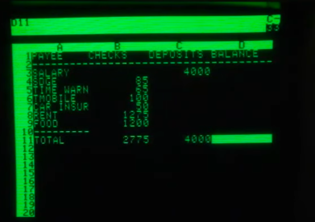
The Magic of Accountants
A brief history of Spreadsheet
http://www.dssresources.com/history/sshistory.html
Software Arts Corporation
Formed on January 2, 1979
https://en.wikipedia.org/wiki/Moore%27s_law
Image source: https://maaw.info/Chapter2.htm
Notes:
活性，安全性，效率

Slide 11
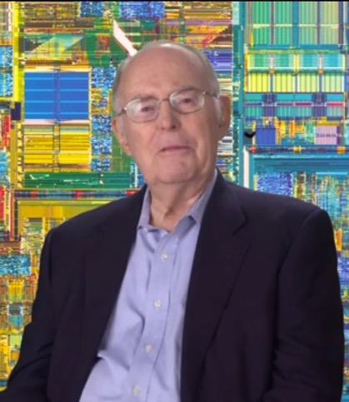

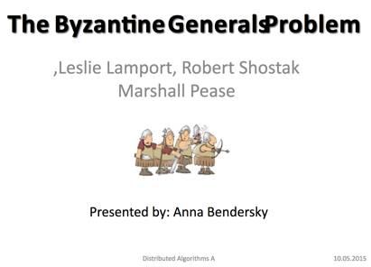
Magicians in Modern Times
找到了计算信息传递可信度的数学理论
拜占庭将军的问题：提出了分布式数据库的可信度检验算法
http://slideplayer.com/slide/4339032/
https://medium.com/@amuse/how-the-nsa-caught-satoshi-nakamoto-868affcef595

Slide 12
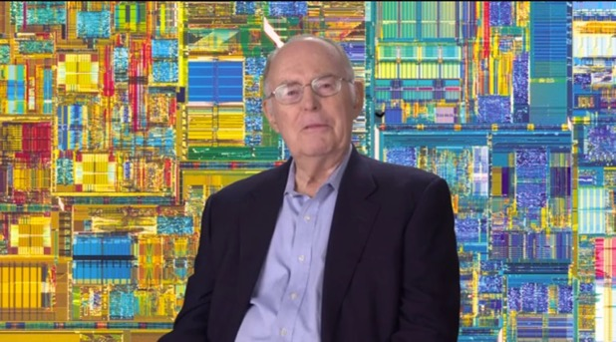
The Magical Spell that governed the World’s for 50 years
西方刘伯温
硅谷的烧饼歌/推背图
因特尔创始人摩尔，以科技成熟度的数据为论述，精准地规范了全球产业格局的发展趋势，长达五十年。
以单位购买力计算：2⁵⁰⁼ 1.25* 10^{15 ～}一千万亿倍
https://en.wikipedia.org/wiki/Moore%27s_law

Slide 13
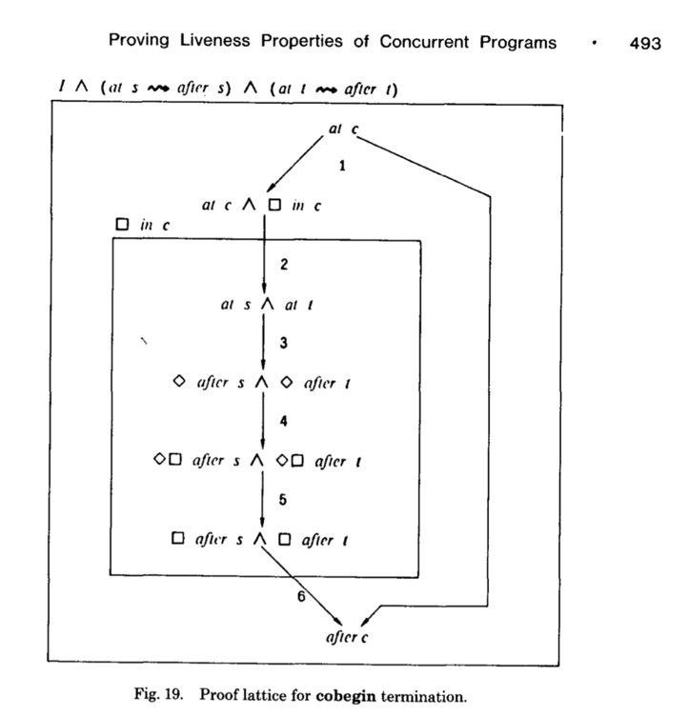
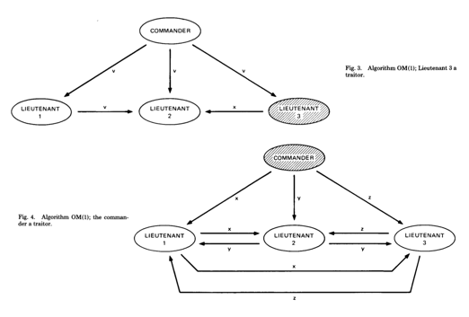
Breaking the Cognitive Boundaries
系统的两类合约：
安全与活性
Safety: （安全）
Something bad never happens
Liveness: （活性）
Something good eventually happen
The Byzantine Generals Problem * 388
找到了计算信息传递可信度的数学理论
拜占庭将军的问题：提出了分布式数据库的可信度检验算法
http://slideplayer.com/slide/4339032/
ACM Transactions on Programming Languages and Systems, Vol. 4, No. 3, July 1982.

Slide 14

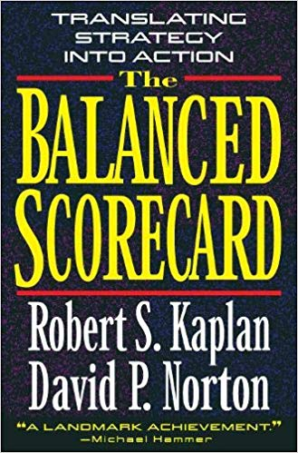
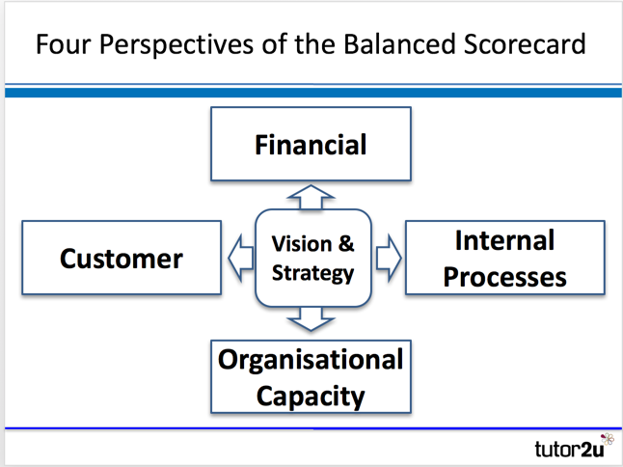

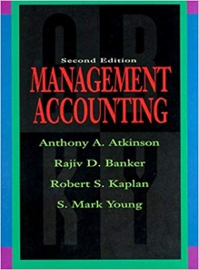
平衡账本的策略决定组织的活性与安全性
平衡积分卡让多方利益相关方，
在有共识数据的基础上，创造价值
Image Source: https://www.tutor2u.net/business/reference/balanced-scorecard-introduction-overview
Robert S. Kaplan
2019, Nov. 15
深坑酒店, Shanghai
Notes:
记账成本如何来进行策略决定，组织战略与执行呢？可以参考Robert S. Kaplan的平衡计分卡

Slide 15

区块链平衡了多类型的资源博弈
平衡积分卡让多方利益相关方，
在有共识数据的基础上，创造价值
比特币白皮书
交易所
Satoshi Nakamoto
币圈
区块链
码农
矿场
以太坊
白皮书
Vitalik Buterin
牛顿项目白皮书
徐继哲
Image Source: https://www.tutor2u.net/business/reference/balanced-scorecard-introduction-overview
Notes:
记账成本如何来进行策略决定，组织战略与执行呢？可以参考Robert S. Kaplan的平衡计分卡

Slide 16
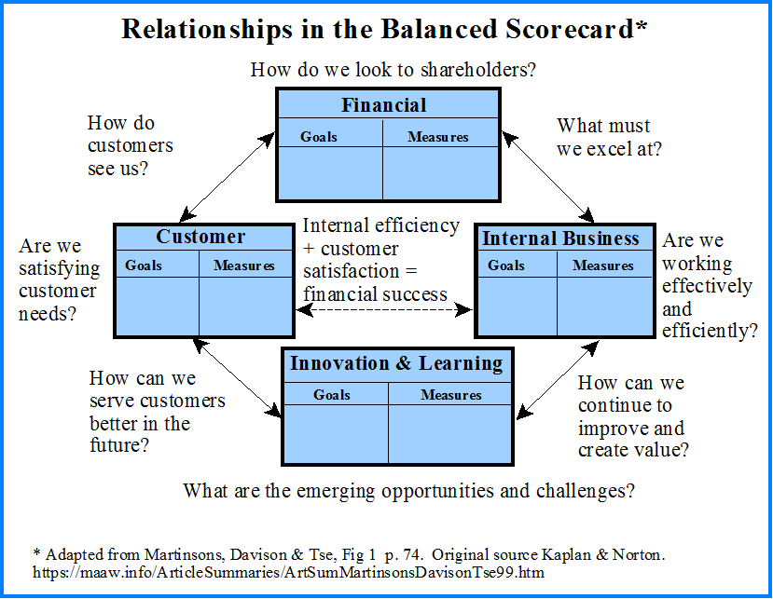
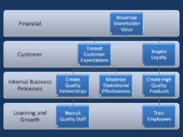
平衡积分卡：利益相关方之间的动态平衡
Strategy Map
https://en.wikipedia.org/wiki/Strategy_map
https://maaw.info/ArticleSummaries/ArtSumMartinsonsDavisonTse99.htm
Notes:
平衡计分卡是从财务、客户、内部运营、学习与成长四个纬度，将组织的战略落实为可操作的衡量指标和目标值的一种新型绩效管理体系。

Slide 17
Logic Model Explained
Ben Koo
koo0905@gmail.com

Slide 18
Context: Describe the Spatial and Temporal boundaries of the project.
Abstract Specification
Goal: Mission Statement written in an imperative sentence with reference to “Context”.
Measurable Effects: Conditional statements of the observable implementation outcomes that satisfy the “Goal”.
Concrete Implementation Process
Inputs
Prescribe the required resources to be consumed in the implementation Process
Activities
A structured set of actions that depicts implementation activities.
Ideally written in a formalized process specification language
Outputs
A list of noun phrases that declares the deliverable items from proposed activities
Boundary Conditions: When and how the boundaries of the previously defined ”Context” could be broken?

Slide 19
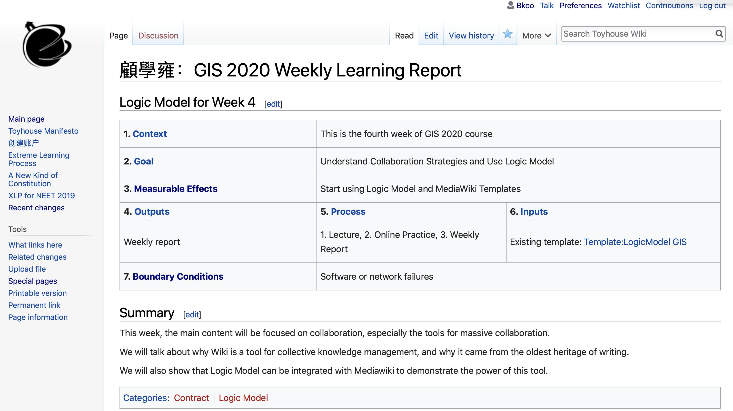
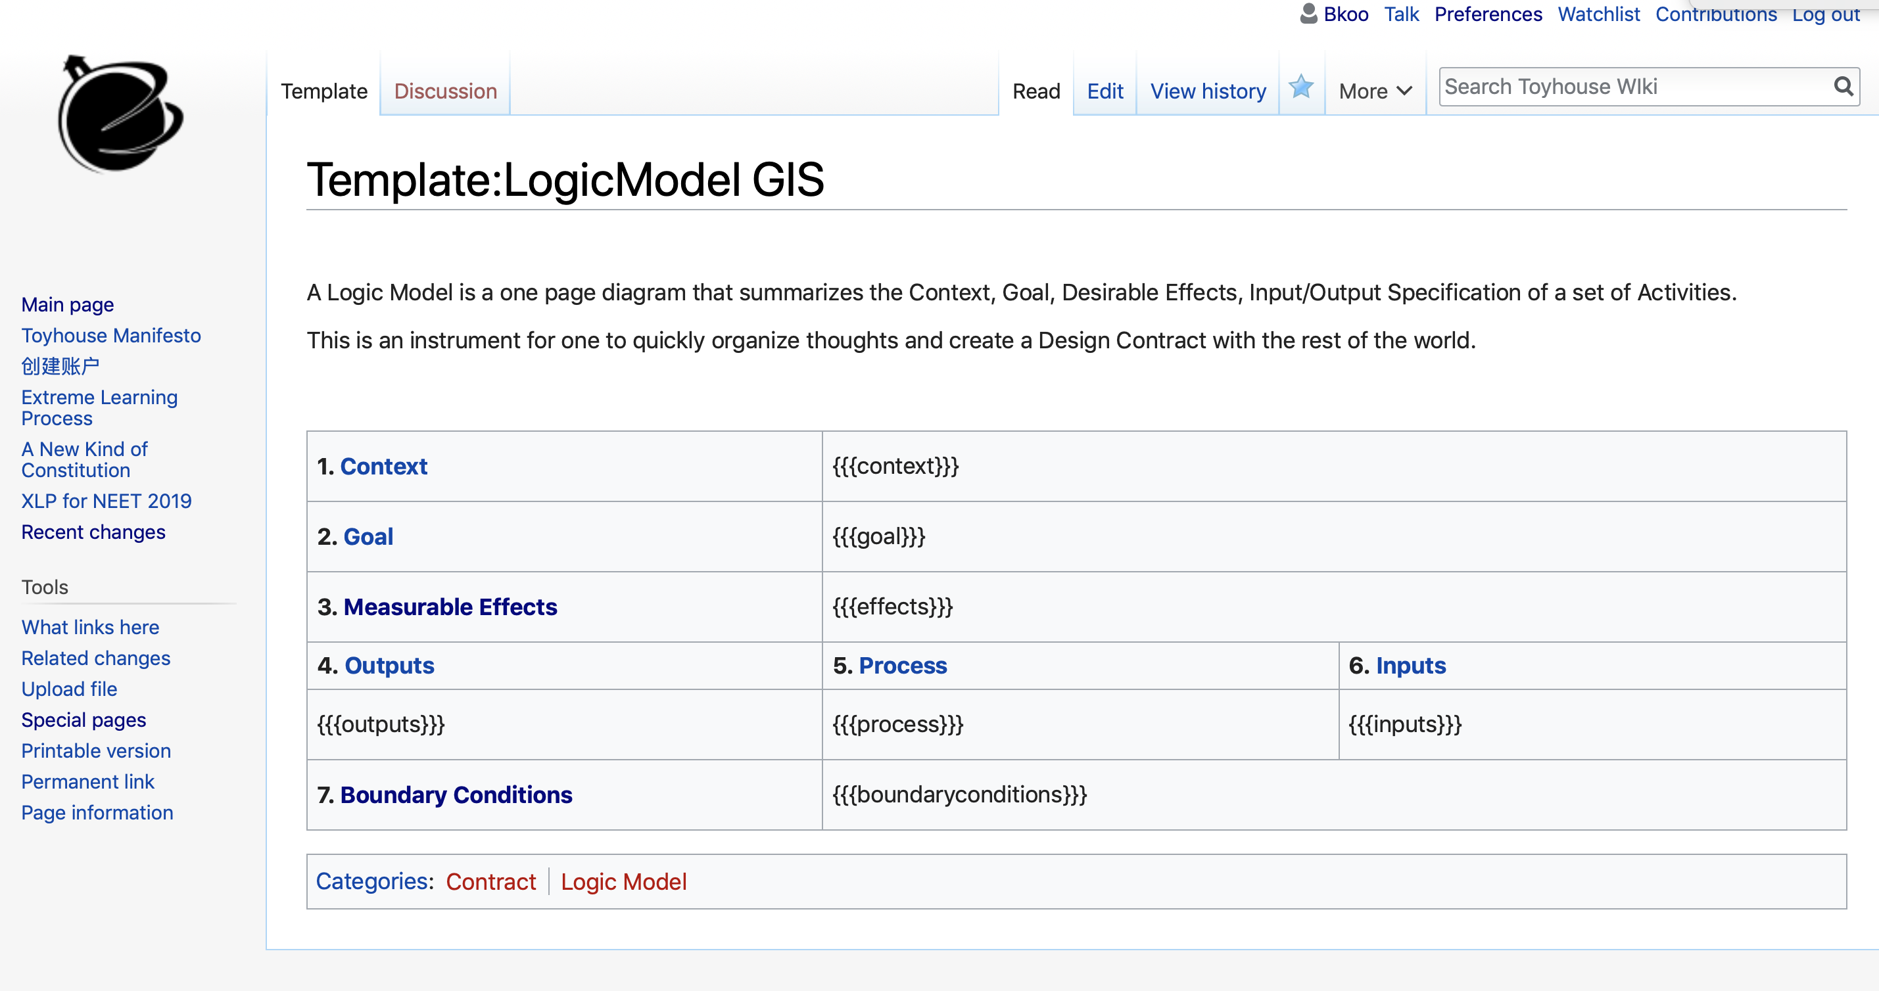
LogicModel Template on MediaWiki
http://toyhouse.wiki:81/index.php/顧學雍：GIS_2020_Weekly_Learning_Report

Slide 20
Context
Describe a Situation’s Temporal and Spatial Context that deserves deliberate project-based actions or the incorporation of an active organization
Goal
An imperative statement that clarify the objectives of planned actions or a proposed organization, given the situations presented in the Background section
Logic Model: The Contract of your work
Effects
Output
Process
Input
Offer the indicators and criteria for desirable outcomes
The indicators and criteria should be multi-faceted and complementary, so that they together ensure meaningful success
Descriptions of desirable outcome should be composed of qualitative and quantitative conditions
Outcome statements should form the basis for OUTPUT (deliverables)
Specify the concrete information content or physical evidence as the measurable effects of the program’s activities。
Witness accounts, evidence of effects
Process data generated by participants of the program
Measurable differences of capabilities, ideas, and other programs.
Project reports, Analysis Reports, Business Proposals, or other types of summative documentation
A list of essential activities in the project or organization
Schedule and priorities
While activities are taking place, state how and what process data can be captured for future analysis
Intermediate Review Meeting with the sponsoring advisors
Interactions with the target service/product audience
Online and offline interaction activities
Initial “Logic Model”
A constitution for the project/organization
Participation Model
Responsibilities
Amendment Process
Infrastructures, equipment, communication bandwidth
Budget
Data and Computational Resources
External Factors
As project proceeds, the content of a Logic Model must be updated, therefore, the speed and consistency of propagating updates is of critical importance. A key reason for keeping Logic Model simple, is to ensure that the amount of time required to refine and transmit Logic Model to its participants is relatively small, therefore, we can increase the speed and consistency of the latest version of Logic Model.

Slide 21
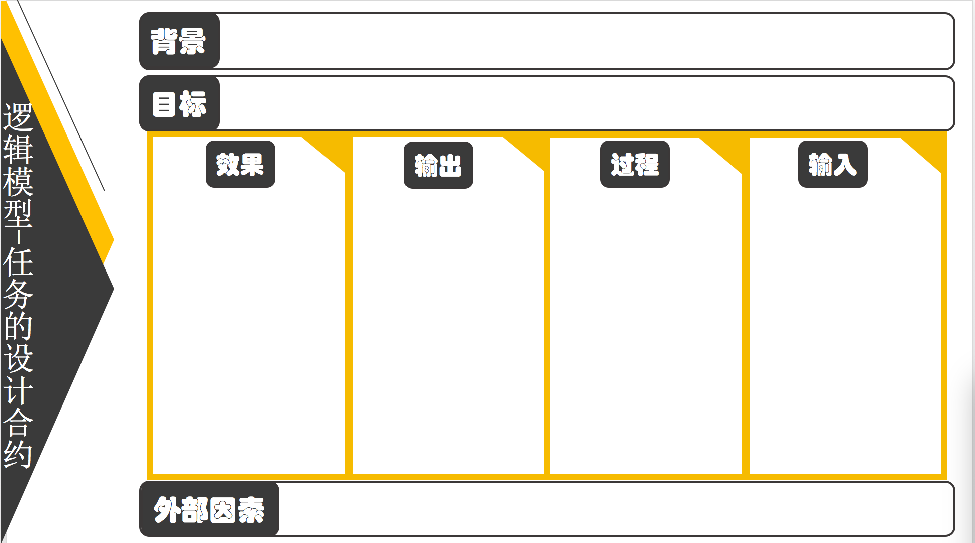
Begin with the End in Mind
1
2
3
4
5
6
7

Slide 22
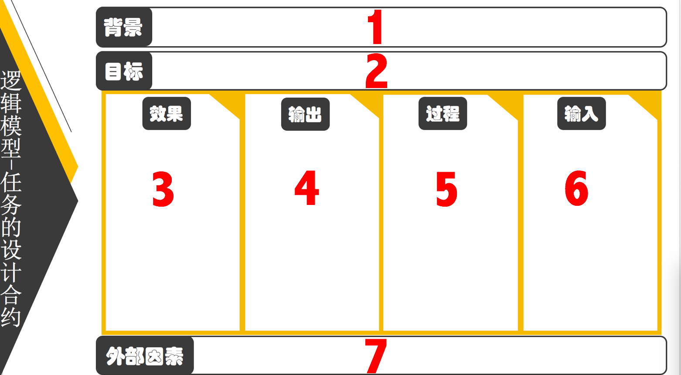
Sequence
Starting with Background、do NOT start with Input.
Follow the sequential number, filling up the seven boxes.
Each box represents one layer of your understanding of the overall system at hand
Your understanding is reflected through your choice of words.
It is necessary to iteratively refine your statements in each box. (Starting from background.)

Slide 23
Context
Logic Model is a tool for inspecting and reviewing project proposals by the Office of General Accounting of the United States of America. It is also used by United Nations
This document is a required communication instrument BEFORE any project starts.
A description of background should portrait a pain point, a situation where something must be done to avoid disaster or to ensure forseeable success.

Slide 24
Sample Background Statements：
In the last ten years, the average GPA of university graduates are constantly increasing, but the employment rate and employability indices are dropping rapidly.
In XYZ vocational school, more than 20 percent of students skip hand-on classes, and many skips classes in general, but the graduation rate is nearly 100 percent, and their starting salary are also increasing.
Note that certain time and categorization of target persons are explicitly stated in Background.

Slide 25
Goal
A concise mission statement, covering multiple layers of objectives
Example：
Context: In XYZ vocational school, more than 20 percent of students skip hand-on classes, and many skips classes in general, but the graduation rate is nearly 100 percent.
Goal：Improve the content and qualification process of hand-on classes in XYZ vocational school, ensure graduating students must have proper professional skills and adequate social conduct.

Slide 26
“Measurable” Effects
Multiple interrelated outcome statements，explicitly qualify complementary conditions to ensure the outcomes matches the goal
Example：
Goal：Improve the content and qualification process of hand-on classes in XYZ vocational school, ensure graduating students must have proper professional skills and adequate social conduct.
Effects：
Require students to pass a series of third-party professional skill qualification service before graduation
Establish a privacy-protecting learning process data recording system for class attendance, so that students can demonstrate and present their formative records to potential employers without exposing privacy。

Slide 27
Output
The Outcome statements should be satisfied by at least one Output item
Example：
Outcome：
Require students to pass a series of third-party professional skill qualification service before graduation
Establish a privacy-protecting learning process data recording system for class attendance, so that students can demonstrate and present their formative records to potential employers without exposing privacy。
Output：
Third Party Skill Verification Service and Examination Material/Process
Student’s Learning Process Data collected and Protected by Secure Data services

Slide 28
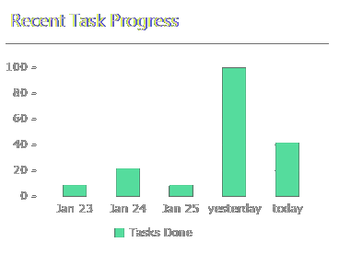
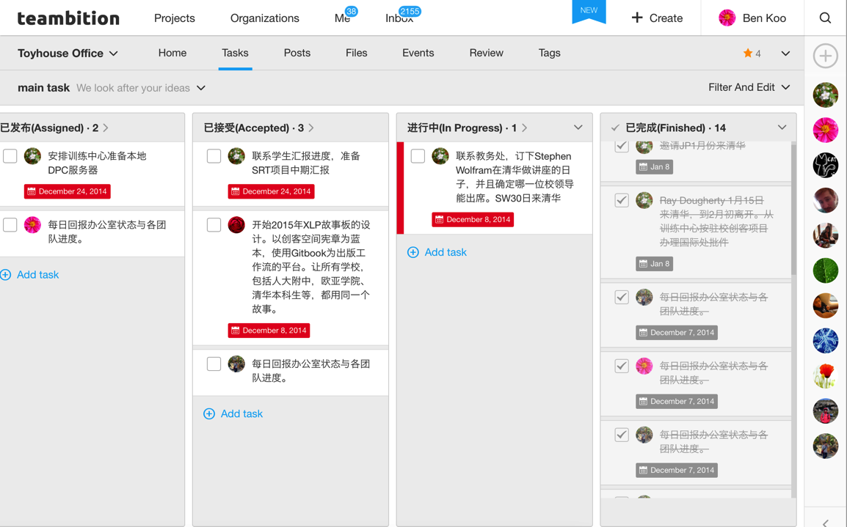
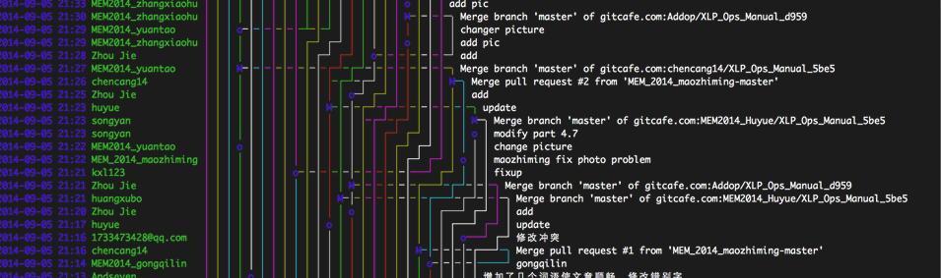
ABC Learning Process Data is a kind of Output

Slide 29
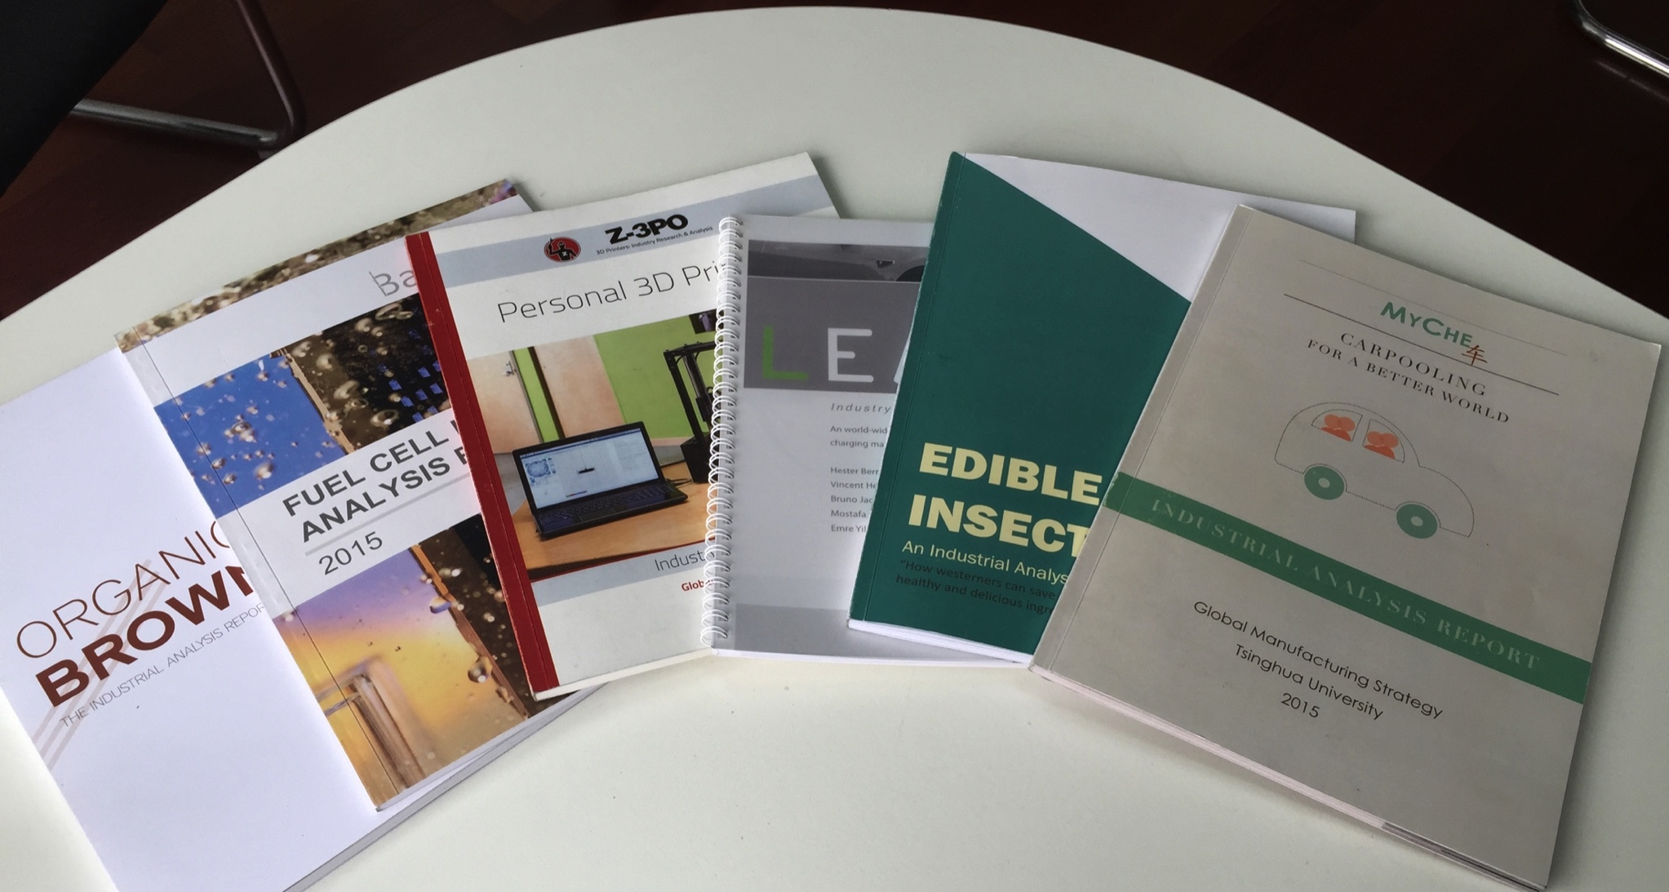
Paper-based Publication is a kind of output
Notes:
14

Slide 30
Process：The methods of that creates output
Based on the Output, Define relevant Activities that would deliver the output
Example：
Output：
Third Party Skill Verification Service and Examination Material/Process
Student’s Learning Process Data collected and Protected by Secure Data services
Process:
Review 3rd Party Examination Services, Select the most reliable service agency or agents
Select the What Data to collect
Choose how to Collect Data
Data Collection Technology
Data Privacy Protection Technologies

Slide 31
Input
Given the Process(es), identify the required resources to conduct the activities:
Example：
Process:
Review 3rd Party Examination Services, Select the most reliable service agency or agents
Select the What Data to collect
Choose how to Collect Data
Data Collection Technology
Data Privacy Protection Technologies
Input:
A list of available 3rd Party Professional Skill Qualification Services
Learning Process Data analysis experts
Learning Process Data collection experts

Slide 32
External Factors
Enumerate any factors that might cause the project to fail or to become out of context.
Example：
Students share their passwords, confounding data collected
Participants do not use the data collection device, not enough data can be collected in time
Due to smog, students are asked to not attend classes in general

Slide 33
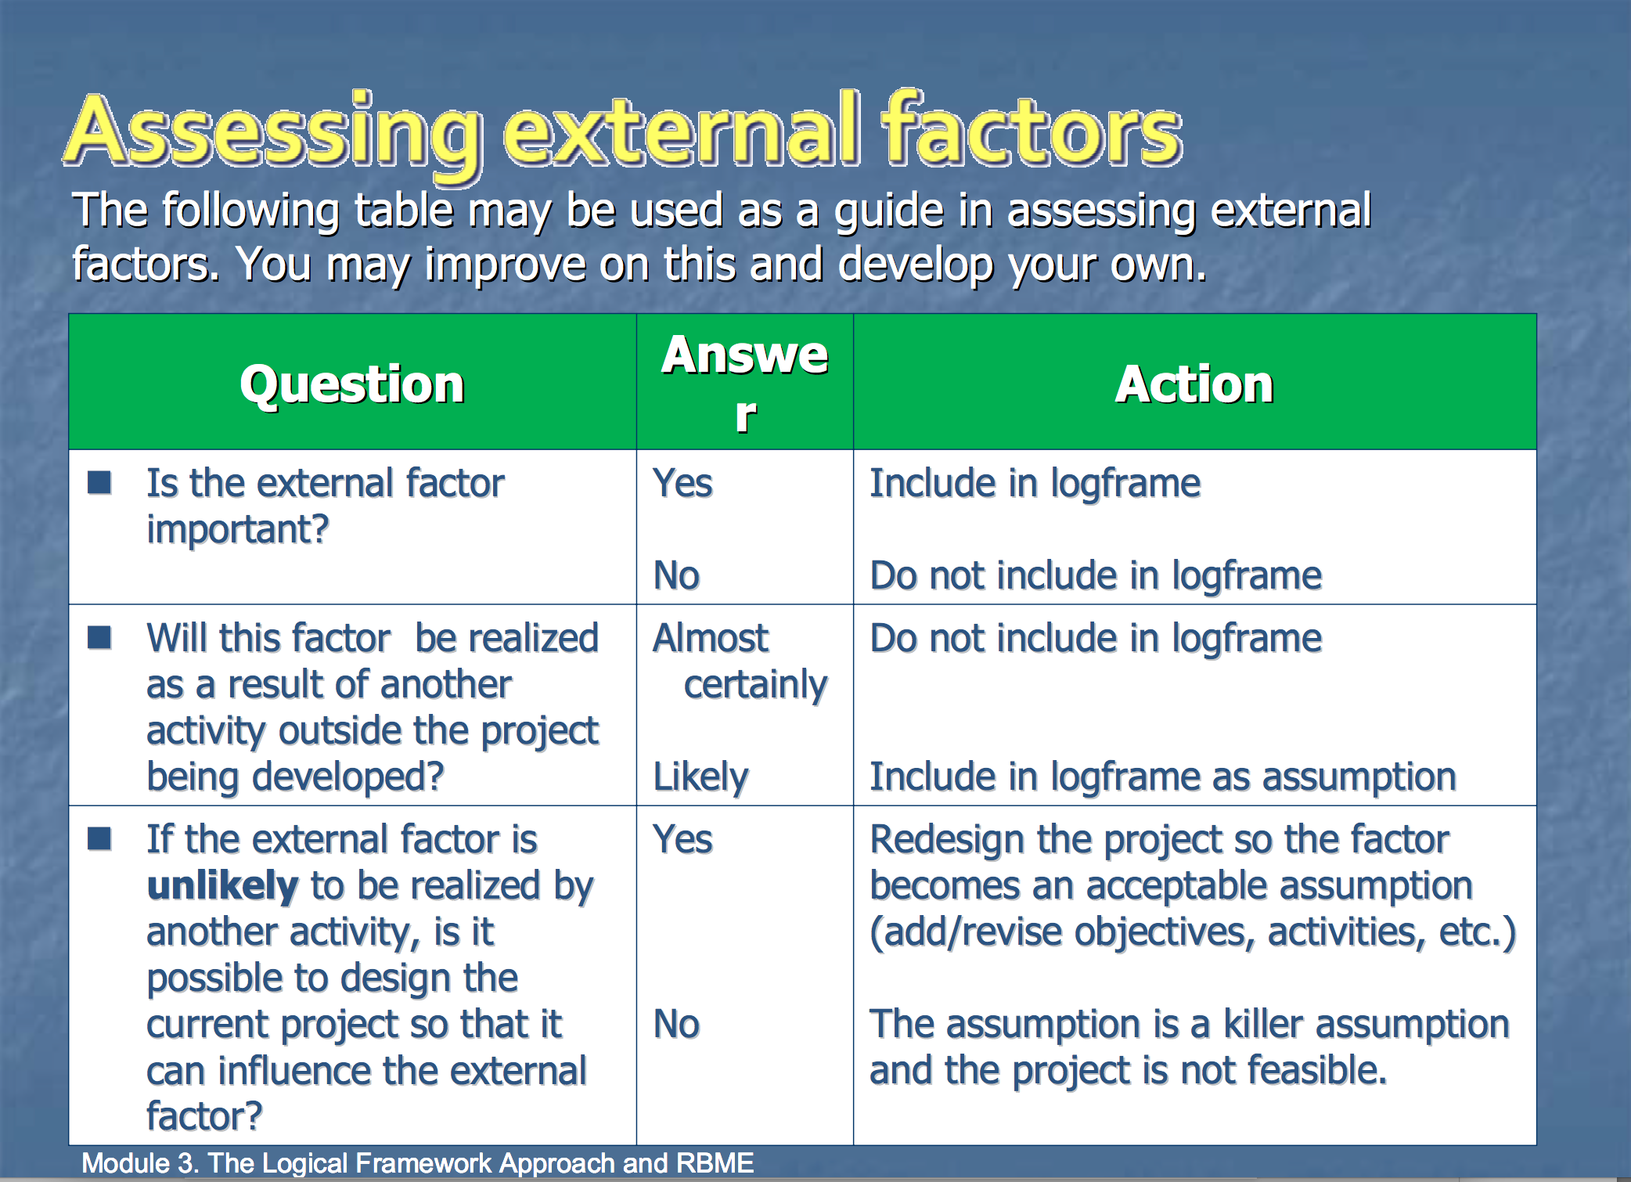
Assessing external factors

Slide 34
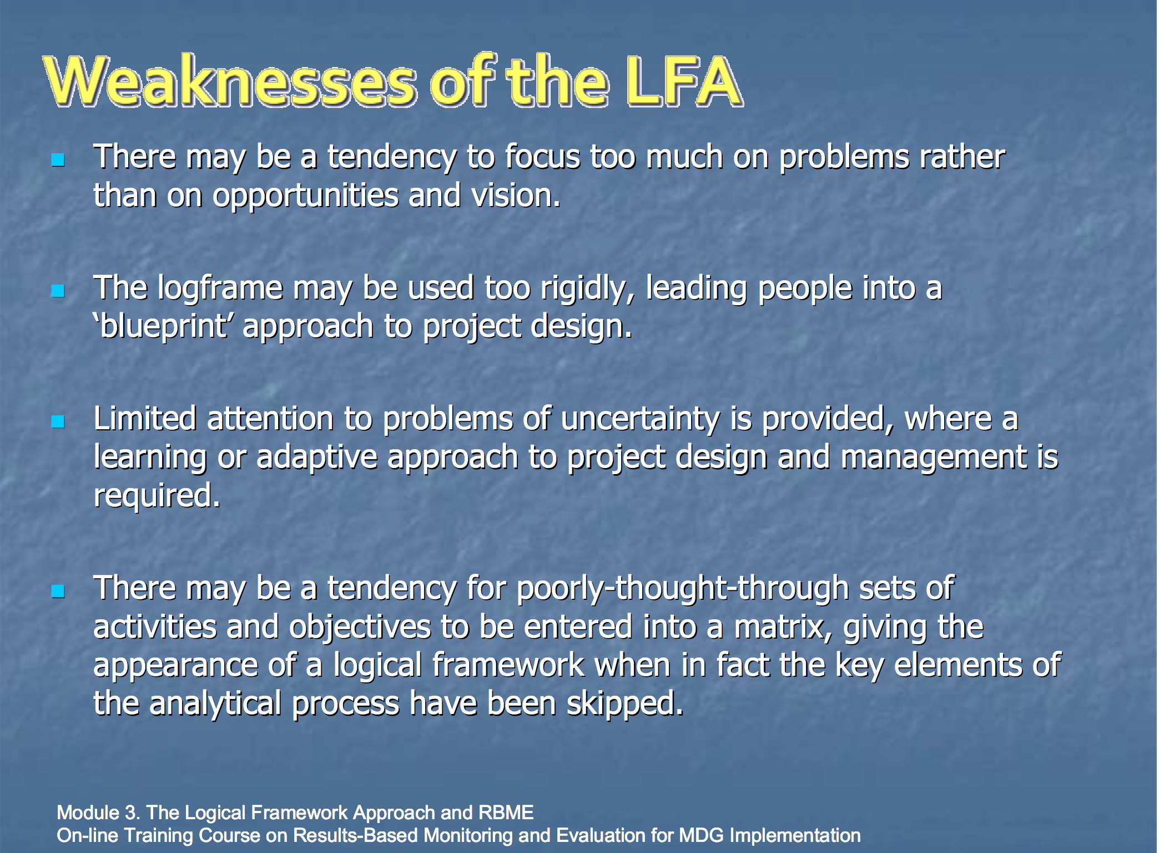
Weaknesses of the Logic Model

Slide 35
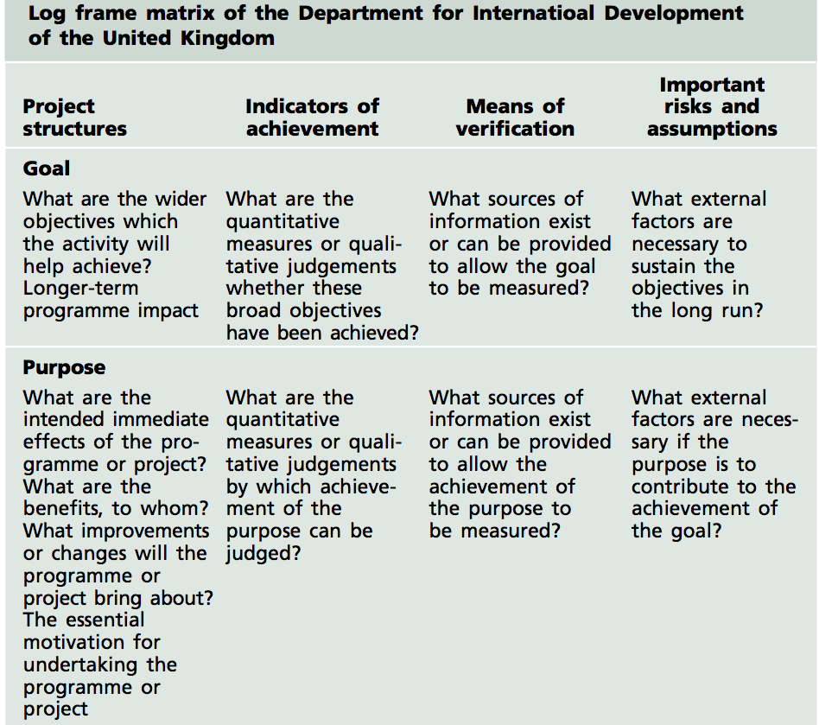
Logic Frame of the UK

Slide 36
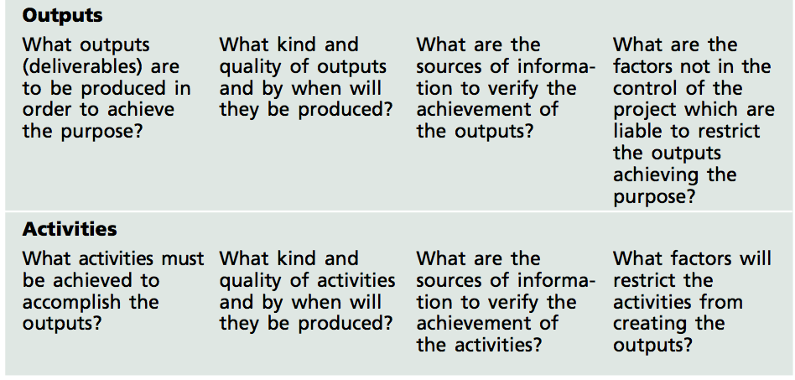
Logic Frame of the UK

Slide 37
Logic Frame of the UK

Slide 38
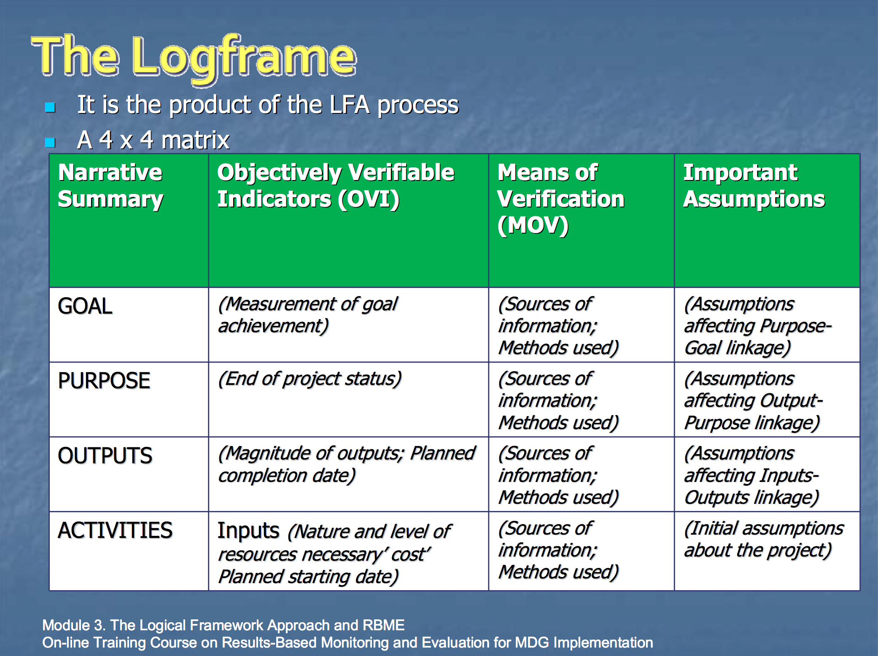
The LogFrame

Slide 39
A reminder of the Goal for AESP 2017
Example：
Background: On March 6, 2017, a group of China-UK students have spent over 3 months creating at least 10 Business Plans...
Goal：Improve the content and presentation of existing Business Plans, so that all plans are ready to be served to Dragons in iCenter’s Den on Friday, March 10, 2017.

Slide 40
Reference Material
David Allen, Getting Things Done: The Art of Stree Free Productivity, Penguin Books, Revised Edition, 2015, p. 163~169
Department for International Development of the United Kingdom, Tools for Development: a handbook for those involved in development activity (2002):
Electronic Resource: The Logic Frame Approach http://unpan1.un.org/intradoc/groups/public/documents/UN/UNPAN032814.pdf Last Accessed: March, 6, 2017

